Slide 1
Beyond Limits Website
1
Presentation of Prototype one

Slide 2

Aims and Goals
2
Early Look – limited functionality
If you don’t like something it’s not set in stone
Remain in contact to get the website right
Second prototype 08/02/2019
  Almost final look of the website
  Most of the features implemented
  Improvements over the last month

Slide 3
Deliverables
3
Volunteering Form
Image Carousel
Admin Page
Database
General Webpages

Slide 4
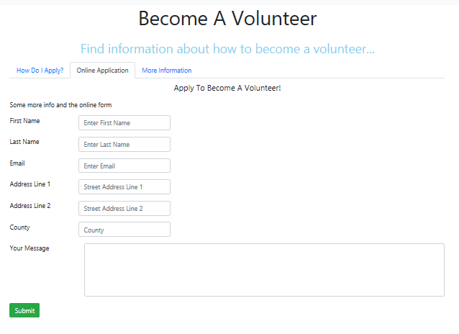
Volunteering Form
4
Simple
Concise
Easy to use
Automatic Email

Slide 5
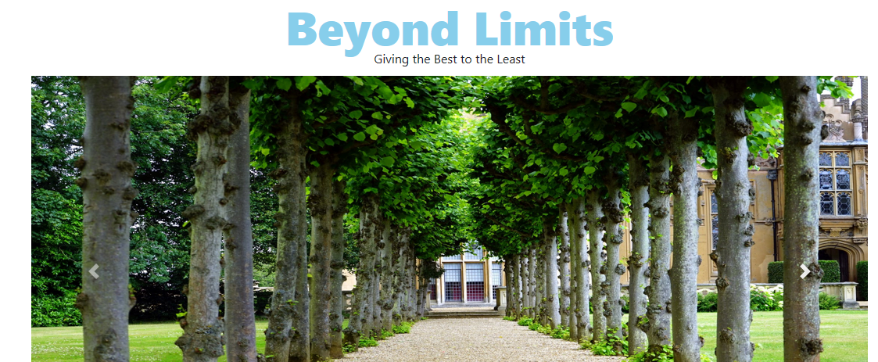
Image Carousel
5
Implemented on the home page
Will make a good first
impression of the website
Can be edited using the
admin page

Slide 6
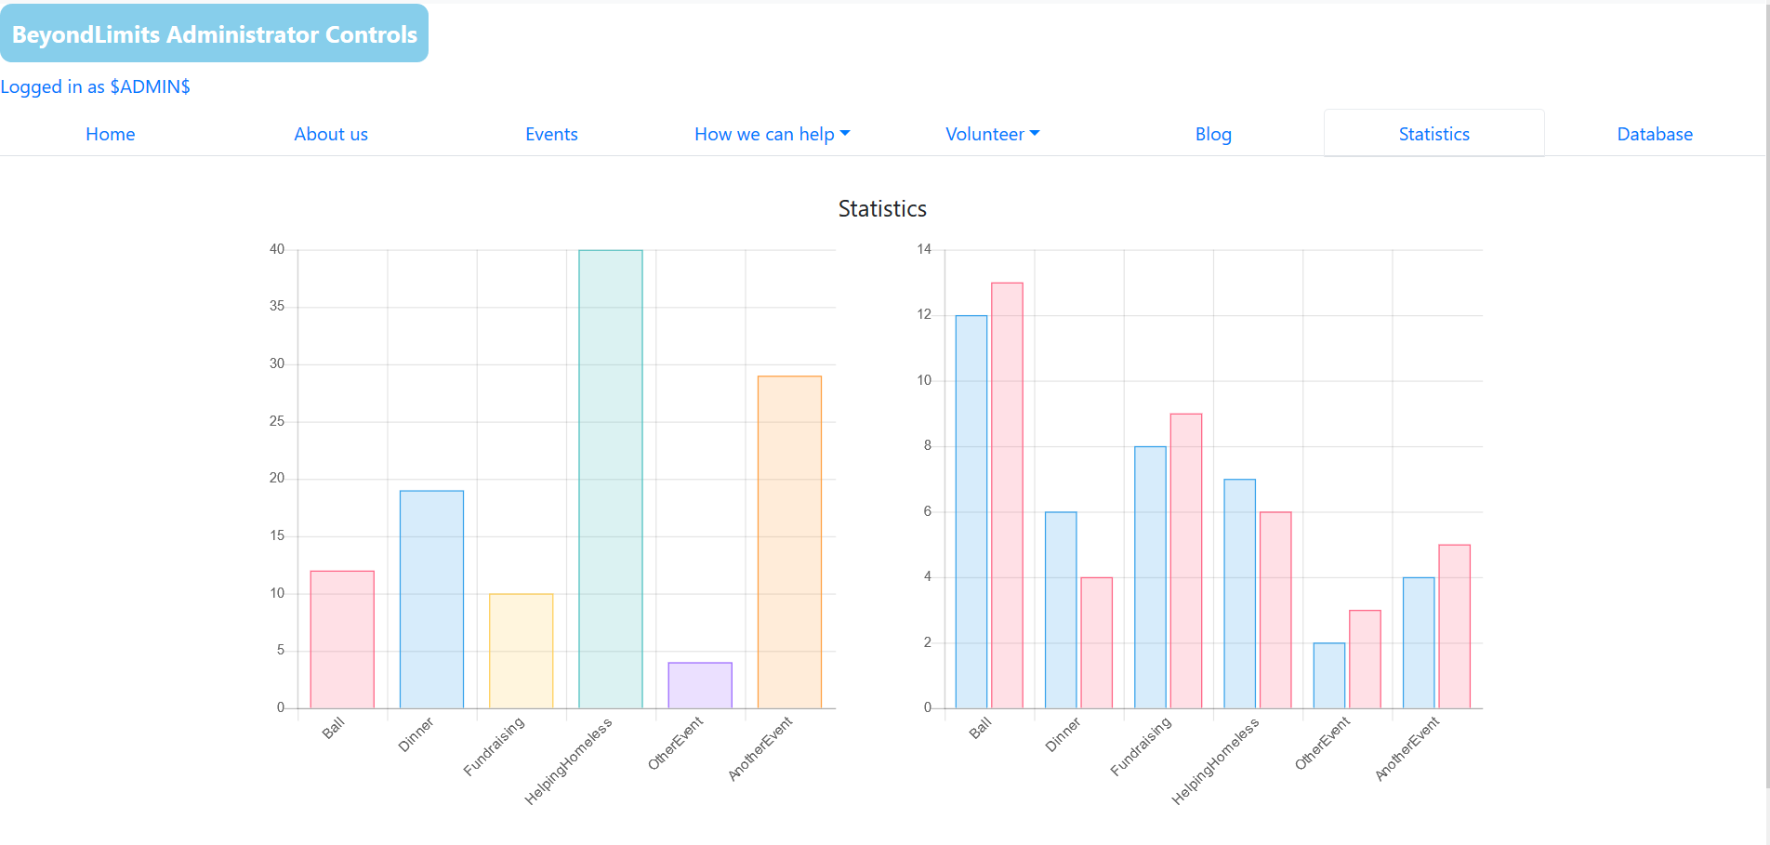
Admin Page
6
Accessible through a separate link
Gives control over various features of the website
Shows various statistics taken
from the database
Will be password protected

Slide 7
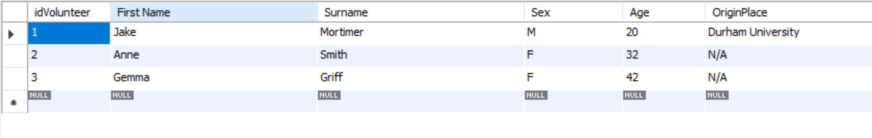
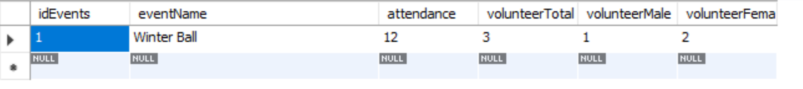
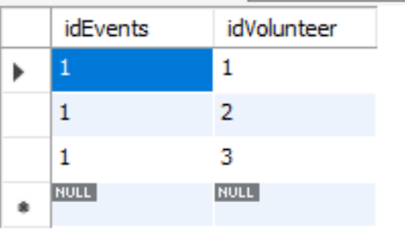
Database
7
Stores:
  Events
  Volunteers
  Volunteer Assignments
Can be accessed using the admin page

Slide 8
User Stories!!!
8

Slide 9
Website Walkthrough
9
Go through layout and features
Show how to edit the content of the website through the administrator’s panel
Note down any feedback on review sheet as we go through, this will be reviewed and feed into the next prototype
Any further questions or feedback at a later date can be emailed to us

